Slide 1
Lab Assignment #1 Research IDEAS
PSY 15
Mandy Small
January 27, 2021

Slide 2
Welcome to your First Lab Section of PSY 15
Lab sections will give you to tools to complete the weekly assignments. These pieces all work together to create your proposal which is the course project
What can you expect?
A video explaining the assignment for the week
An accompanying power point and assignment rubric

Slide 3
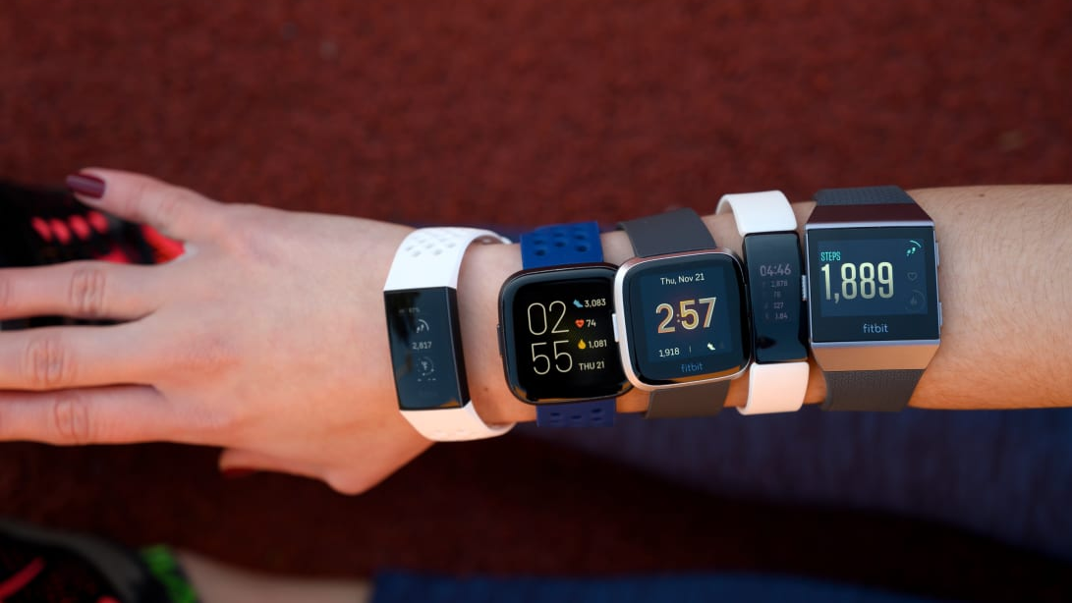
Research IDEAS
A scientist wants to see if wearable technology (such as a Fitbit) increases physical activity in college students
Time to design a study
Independent variable: wearing a Fitbit
Dependent variable: level of physical activity
The independent variable is the one the experimenter controls. The dependent variable is the variable that changes in response to the independent variable

Slide 4

What Makes a Strong Research Question?
Specificity: General questions are hard to answer.
Researchable: Can the question be answer with a study or experiment
Clear: Your variables should be apparent
Population: Who does the question apply to?

Slide 5
Example
Weak Research Idea: “Do Fitbits work?”
Issues with this idea:
What does work mean? Work for who? What are your variables? How would someone answer the question?
If you must ask a lot of question to understand the idea, it’s probably not a good research idea….. But it can be a good starting place.
Strong version: “Does wearing a Fitbit Charge HR increase the number of steps taken per day by undergraduate students?”
This question tells you a lot about the study right away!

Slide 6
Some more Question Examples
Does taking daily nature walks improve high school students’ academic achievement?
Can exposure to bright colors effect blood pressure in health adults?
Is musical tastes related to introversion or extroversion in young adults?

Slide 7
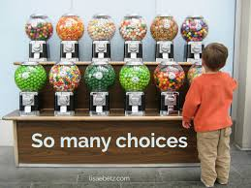
Selecting A Research Topic
Infinite research idea
Only one project
Be sure you are excited to work on the idea all semester!

Slide 8
Assignment #1 Instructions
Come up with three ideas for potential research topics and write each one out as a research question. Identify the independent and dependent variable for each question.
Then identify the research question you plan to use as your topic for the course project.
Your ideas should be:
Psychological in nature
Add to the scientific literature (new)
Something you care about
Assignment #1 is worth 10 points

Slide 9
Independent and Dependent Variable
Does taking daily nature walks improve high school students’ academic achievement?
IV = exposure group (those who walk in nature vs. control)
DV = academic performance
Can exposure to bright colors effect blood pressure in health adults?
IV = exposure or not to bright colors
DV = blood pressure
Is musical tastes related to introversion or extroversion in young adults?
IV = favorite type of music
DV = level of introversion or extroversion

Slide 10
Formatting and Due Date
Type this assignment.
Include your name and section number.
Submit your work to CatCourses by 9:30 AM on Wednesday, February 3rd (no late work will be accepted).
Pdf format only

Slide 11
